Slide 1

Exploring OpenAI in Manufacturing
Christian Thilmany and Sara Benhamron
Global Partner Solutions US

Slide 2


Our partnership with OpenAI
Ensure that artificial general intelligence (AGI) benefits humanity.
Empower every person and organization on the planet to achieve more
Notes:
I will first cover what Microsoft’s relationship is with OpenAI, introduce Azure OpenAI service and also share a few dominant use cases within Financial Service in each vertical. The objective is seed these use cases to help you scout for new FSI solution candidates that we can have downstream 1on1 envisioning sessions with you.
As you all might know, OpenAI is a research lab. Microsoft has heavily invested in it as well.
OpenAI consists of a team of researchers and engineers dedicated to advancing artificial intelligence in a way that it benefits humanity as a whole. Their mission snuggly fits with the Microsoft’s mission of empowering every person and organization on the planet to achieve more.
OpenAI conducts research across various fields of AI, including
Natural language processing (NLP) models such as GPT-3, which can generate human-like text, answer questions, and perform a wide range of language tasks
Computer Vision - algorithms that can recognize and understand visual data such as images and videos.
Robotics - intelligent robotics systems that can learn from human demonstrations and perform complex tasks in the real world.
Reinforcement Learning - a form of machine learning that involves training agents to make decisions based on rewards and punishments, to create intelligent systems that can learn from experience.

Slide 3

Azure OpenAI Service
Deployed within your Azure subscription, secured by you, accessed only by you, and tied to your datasets and applications
Large, pretrained AI models to unlock new scenarios
GPT-3
Codex
Custom AI models fine-tuned with your data and hyperparameters
DALL·E (preview)
ChatGPT coming soon
Built-in responsible AI to detect and mitigate harmful use
Enterprise-grade security with role-based access control (RBAC) and private networks
Notes:
What is Azure OpenAI Service?
Azure OpenAI is a combination of two technologies - Microsoft Azure and OpenAI with the objective of building enterprise-grade applications.
Based on the partnership with OpenAI, Microsoft is delivering on three main goals:
1) To utilize Azure's infrastructure, including security (private networking) as well as compliance, and regional availability, to help our partners & customers build enterprise-grade applications.
2) To deploy OpenAI AI model capabilities across Microsoft products, including and beyond Azure AI products.
3)To use Azure to power all of OpenAI's workloads.
Models include: GPT-3, Codex, and DALL-E and ChatGPT coming soon. These models can be easily adapted to your specific task including but not limited to content generation, summarization, semantic search, and natural language to code translation.
The solutions are deployed to your Azure Subscription
A wide range of pre-trained AI models: Developers can access and use pre-trained AI models developed by OpenAI, such as GPT-3, to add advanced capabilities to their applications.
Tools for fine-tuning models: Developers can fine-tune pre-trained models to adapt them to specific use cases, such as natural language understanding or computer vision.
APIs for interacting with the models: The service provides a simple, consistent API for interacting with the models, which makes it easy for developers to integrate the models into their applications.
Scalability and reliability: The service is built on Azure, which means that it can scale to handle large amounts of data and traffic and is highly available and reliable.
Security and compliance: The service is designed to meet a wide range of security and compliance requirements, and is built on Azure, which provides a number of built-in security and compliance features.

Slide 4
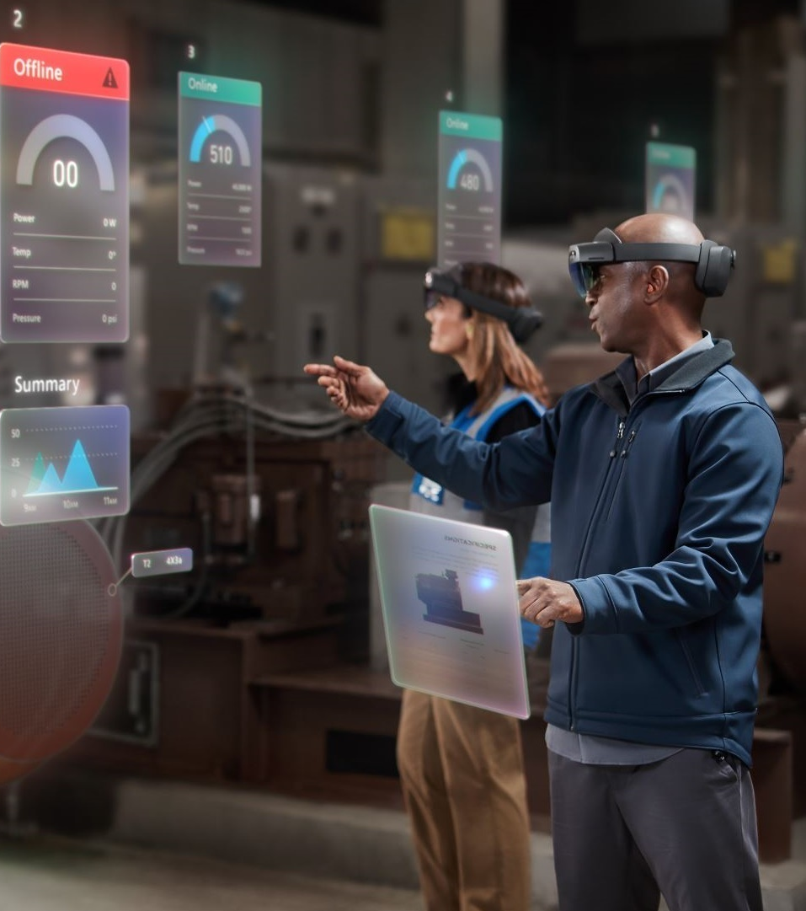
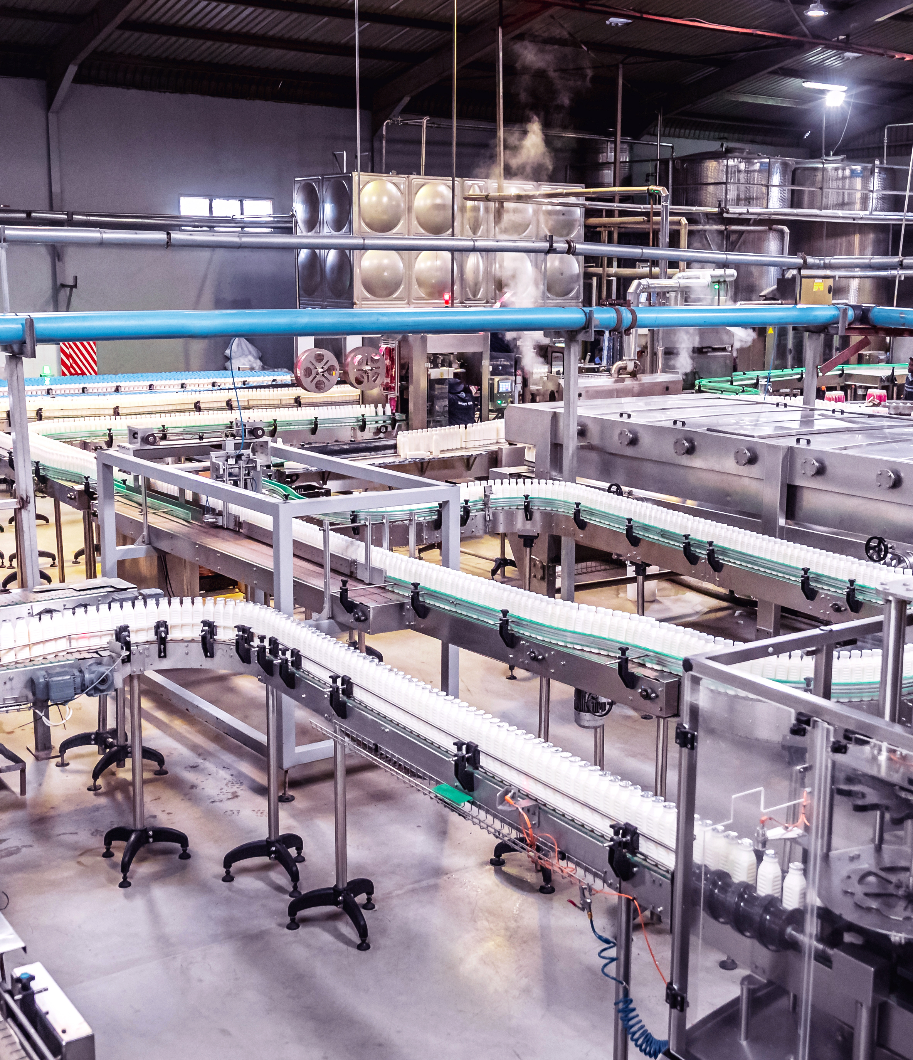

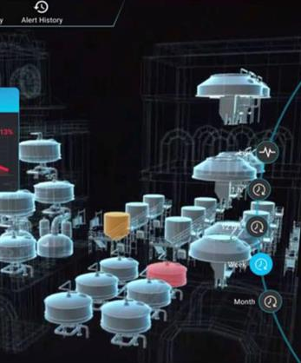

Microsoft in Manufacturing & Mobility
Transform your
workforce
Engage customers
in new ways
Build more
agile factory/plants
Create more resilient supply chains
Unlock innovation and deliver new services
Sustainability | Security | Compliance

Slide 5
Azure OpenAI Service in Manufacturing & Mobility
Key Areas for Azure OpenAI Service to add value in our industry
These are new with
Azure OpenAI Service—Generative AI
These are improved
with Azure OpenAI Service
Create
Generative AI systems generates text, images, audio, writing samples, and other artifacts that can be built with computer-controlled systems like 3D printers
Industry customer scenario
Demand forecasting
Automated quality inspection
Predictive maintenance
Remote asset monitoring
Connected smart product
Document process automation
Contact center
Machine translation
Knowledge management
Automated content generation
Analytics
Sentiment analysis
Generating reports
Developer productivity
Identify
AI systems identify things like people in pictures, words in speech or handwriting and—most importantly—what's real vs. what's fake

Slide 6

M&M Azure OpenAI Service Scenarios
Demand Forecasting
Issues & Challenges
Azure OpenAI Service Value Add
Potential Outcomes
Disconnected processes
No feedback loop due to limited visibility of key data from the supply chain
Departments operating in silos and restricted data flow
Allow Planners to use natural language to query forecast predictions
Convert unstructured NLP feeds into structured data points
Improve time to value through increased forecast speed and reduction in project time
Reduce inventory carrying costs by predicting necessary stock levels at any given time
Grow revenue by increasing in-stock percentage through stronger forecast accuracy

Slide 7
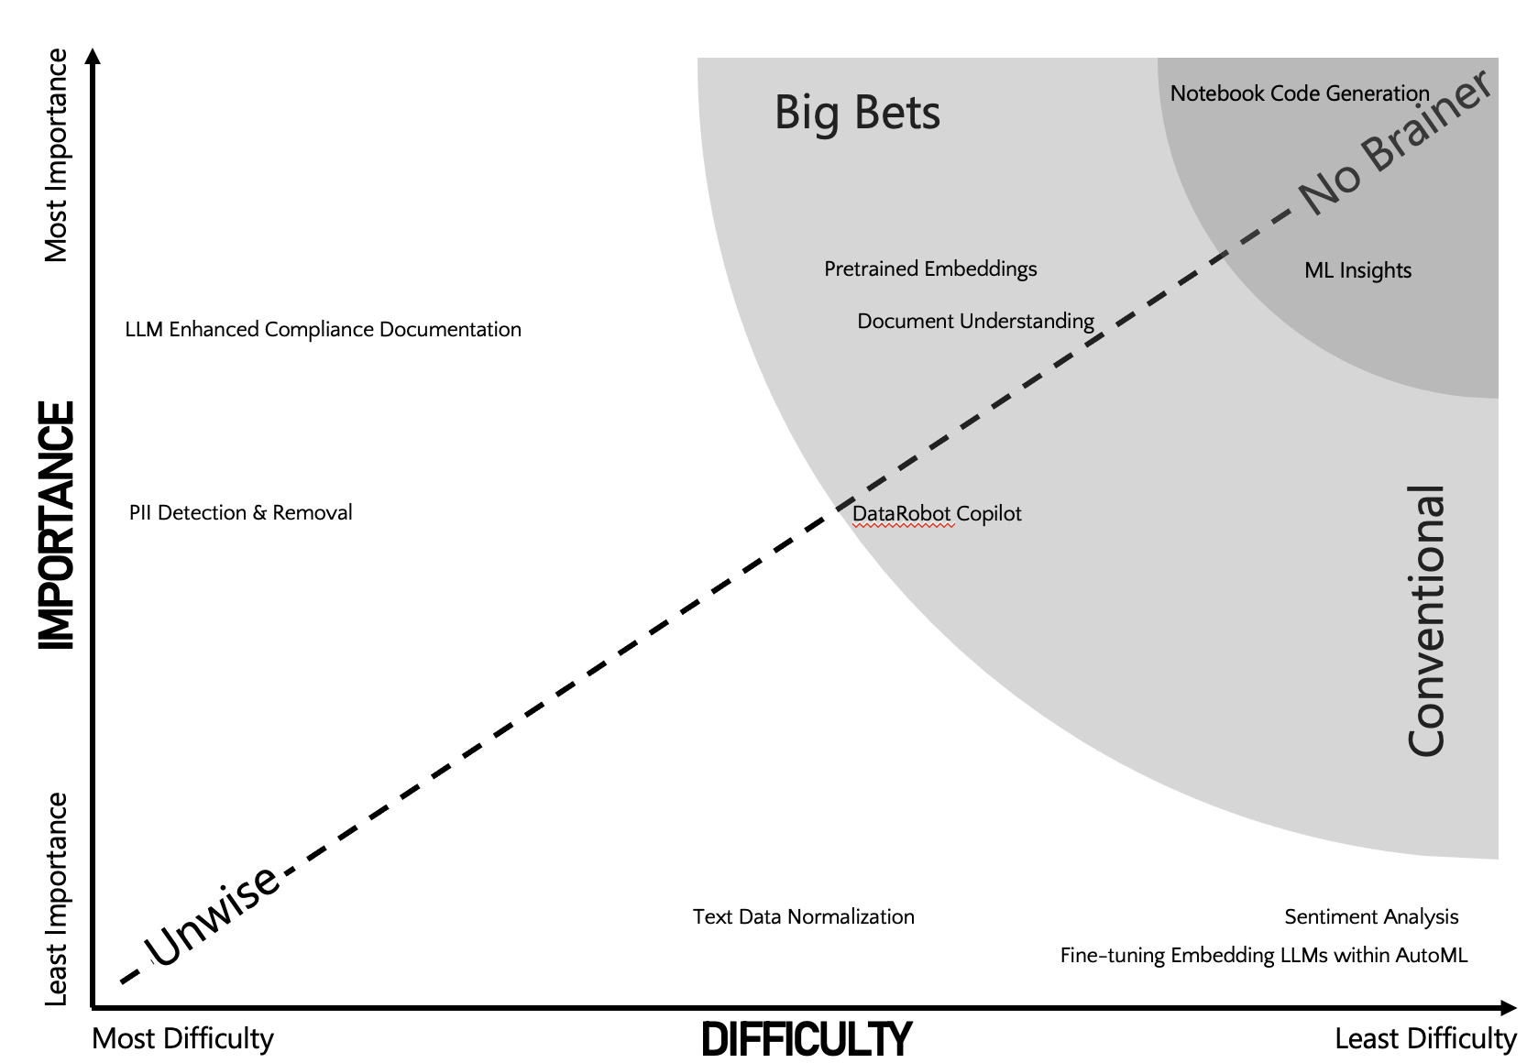
M&M Azure OpenAI Service Scenarios​
Automated Quality Inspection
Issues & Challenges
Azure OpenAI Service Value Add
Potential Outcomes
Latent anomaly detection: Computation and data inference are often performed by remote applications
Lack of data insights: IoT data is siloed and isn’t leveraged for strategic decision-making.
Velocity of developing for the edge: Edge technology requires significant coding and testing in a live environment.
Provide NLP queries on the vision anomalies and causes
Use Synthetic Imaging to augment baseline ML training image volumes to improve ML accuracy and data set sizes
Improve quality assurance pass rates and product yield by
Automating inspection with higher accuracy and redirecting human labor to value adding tasks
Increase customer satisfaction and retention by
Reducing delivery of defective products
Reduce operational costs by catching anomalies faster, reducing amount of inventory that needs to be scrapped

Slide 8
M&M Azure OpenAI Service Scenarios​
Predictive Maintenance
Issues & Challenges
Azure OpenAI Service Value Add
Potential Outcomes
Data is not being captured from the factory floor
Large upfront investment
Security risks on data capture with legacy equipment
Complexity of getting started
Converting unstructured data to structured SQL data points
Improve Knowledge Mining
Increase machinery uptime by Predicting problem areas and solving before they become breaks
Reducing maintenance costs and repair time by
Proactively addressing problem areas before it becomes a larger failure
Reducing inventory carrying costs by Accurately understanding spare part inventory needs at any given time

Slide 9
M&M Azure OpenAI Service Scenarios​
Remote Asset Monitoring
Issues & Challenges
Azure OpenAI Service Value Add
Potential Outcomes
Need to improve equipment effectiveness and asset productivity by capturing and analyzing all connected shopfloor data
Need to avoid unplanned downtime due to unexpected machine failures
Deliver real-time platforms that enable factories to closely monitor daily operation and perform real-time diagnostics remotely
Use NLP to mine knowledge sources
Convert unstructured data to structure data
Convert NLP issues to images for analysis/comparison
Machine learning models generate real-time recommendations across physical processes
Higher overall equipment utilization and asset productivity
Improved employee productivity with freeing up of time for performing more value-added tasks
High app performance and instant efficiency insights worldwide with low latency

Slide 10
M&M Azure OpenAI Service Scenarios​
Contact Center
Issues & Challenges
Azure OpenAI Service Value Add
Potential Outcomes
General staffing shortage
Increase cost of workforce
Increase customer expectation
Speech API & GPT-3 can extract rich insights from call transcripts.
E2E Call Center analysis: classification, sentiment, summarization and email generation.
Automatically generate responses to customer inquiries.
Summary of customer support conversation logs
Improve customer satisfaction
Improve time to resolution of customer inquiries

Slide 11
M&M Azure OpenAI Service Scenarios​
Automated content generation
Issues & Challenges
Azure OpenAI Service Value Add
Potential Outcomes
Too much data to properly curate within a given SLA
Time consuming tasks to summarize product reviews/feedback
Difficult to segment, personalize, and filter reviews/feedback
Generative AI can be used to automatically generate content on a variety of topics, saving time and money for content creators.
Generate more relevant contents with summarization
Improve SEO

Slide 12
How do I get started?
Request Access to Azure OpenAI Service
Learn Azure OpenAI Service
Build intelligent
app experiences
with Azure AI
https://aka.ms/oai/access
https://aka.ms/azure-openai
Reach out to your Microsoft Account Team/contact for an envisioning session to nail down the specific use case.
Notes:
Let’s walk through a few potential starting points.
We’re so excited Azure Open AI, and hope you are too! Over to you Sara
Sara can close

